Slide 1
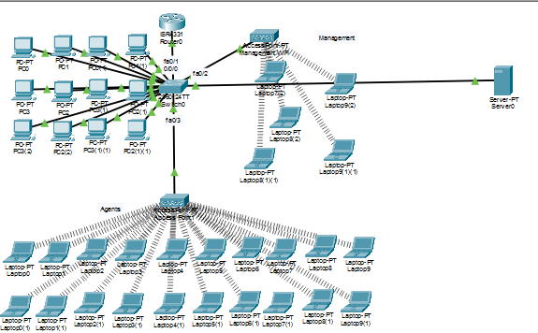
CISCO PACKET TRACER · NETWORK SIMULATION
Corporate Network
Setup
Independent Server Providing DNS & DHCP
Across Multiple VLANs & Wireless Zones
DNS Server
DHCP Pools
4 VLANs
Wi-Fi Zones
Designed and simulated in Cisco Packet Tracer

Slide 2
Project Overview
PROJECT BRIEF
🏢 Scenario
🌐 Independent Server
Simulate a large corporate network with two physical office zones and multiple device groups using Cisco Packet Tracer.
A single dedicated Server0 (IP: 192.168.10.10) provides DNS and DHCP services to all VLANs via ip helper-address.
🔀 Network Segmentation
📶 Wireless Access
Four VLANs: PC_LAN (VLAN 2), MANAGEMENT (VLAN 3), AGENTS (VLAN 4), and SERVER_ZONE (VLAN 10).
Two Wi-Fi zones (Management & Agents) via dedicated Access Points with WPA2-PSK security.
IP Address Plan

Slide 3
IP Address Plan & VLAN Structure
NETWORK DESIGN
Device / Role | VLAN | IP Address | Subnet | DHCP Pool Range
Server0 (DNS/DHCP) | VLAN 10 – SERVER_ZONE | 192.168.10.10 (static) | 255.255.255.0 | N/A (static)
Router0 – GE0/0/0.2 | VLAN 2 – PC_LAN | 192.168.2.1 (gateway) | 255.255.255.0 | 192.168.2.50–255
Router0 – GE0/0/0.3 | VLAN 3 – MANAGEMENT | 192.168.3.1 (gateway) | 255.255.255.0 | 192.168.3.50–255
Router0 – GE0/0/0.4 | VLAN 4 – AGENTS | 192.168.4.1 (gateway) | 255.255.255.0 | 192.168.4.50–255
Router0 – GE0/0/0.10 | VLAN 10 – SERVER_ZONE | 192.168.10.1 (gateway) | 255.255.255.0 | 192.168.10.50–255
💡 Key Concept — ip helper-address
Because the server and clients are on different VLANs, each router sub-interface uses ip helper-address 192.168.10.10 to forward DHCP broadcast requests unicast to the server.

Slide 4
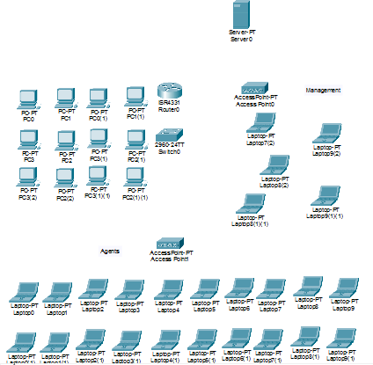
Step 1 – Place Hardware
HARDWARE SETUP
🖥️ Server0
Provides DNS + DHCP (static IP)
🔀 Router0
ISR-331 – inter-VLAN routing
🔌 Switch0
2960-24TT – VLAN segmentation
💻 PC0–PC3 (×2)
Office PCs (VLAN 2 – PC_LAN)
📶 Access Point0
Management Wi-Fi (VLAN 3)
📶 Access Point1
Agents Wi-Fi (VLAN 4)
💻 Laptops ×10+
Management & Agents wireless

Slide 5
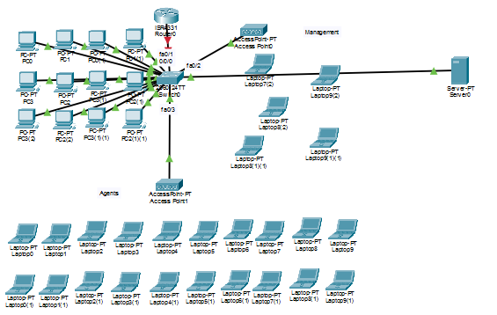
Step 2 – Cabling & Topology
CABLING
▸ Server0 → Switch0
Straight-through copper
▸ Router0 → Switch0
fa0/1 trunk port (802.1Q)
▸ Switch0 → PCs
fa0/4–fa0/15 access ports
▸ Switch0 → AP0
fa0/2 (VLAN 3 – MANAGEMENT)
▸ Switch0 → AP1
fa0/3 (VLAN 4 – AGENTS)
▸ Switch0 → Server0
Dedicated server zone port
⚠️ All PCs use straight-through copper. Router trunk uses 802.1Q encapsulation per sub-interface.

Slide 6
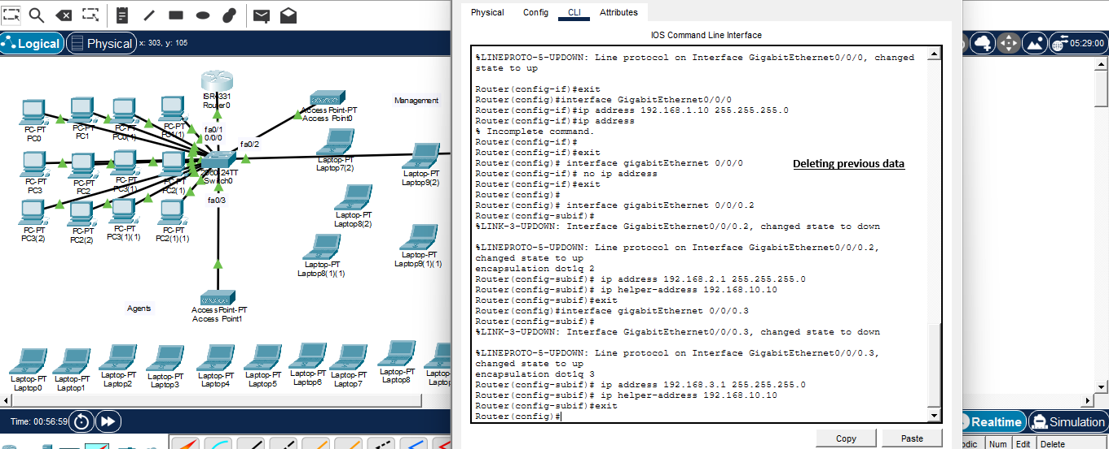
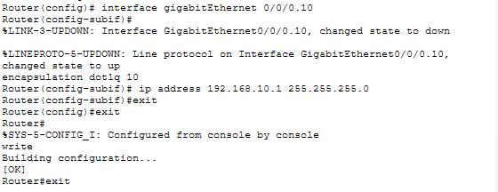
Step 3 – Router Configuration
ROUTER CONFIG – PART 1
Sub-Interface Creation
1. Enter global config mode on Router0
2. Delete any existing Gi0/0/0 IP address
3. Create sub-interface Gi0/0/0.2 for VLAN 2 (PC_LAN)
4. Set encapsulation dot1q 2 and IP 192.168.2.1
5. Add ip helper-address 192.168.10.10 to relay DHCP
6. Repeat for sub-interfaces .3, .4, and .10

Slide 7
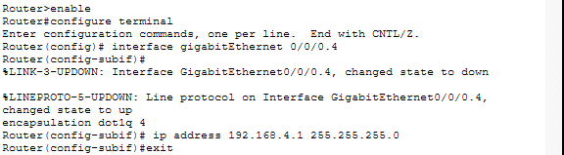
Step 3 (cont.) – VLAN 4 & VLAN 10 Sub-Interfaces
ROUTER CONFIG – PART 2
Key CLI Commands
interface gigabitEthernet 0/0/0.4
encapsulation dot1q 4
ip address 192.168.4.1 255.255.255.0
ip helper-address 192.168.10.10
!
interface gigabitEthernet 0/0/0.10
encapsulation dot1q 10
ip address 192.168.10.1 255.255.255.0
write memory

Slide 8
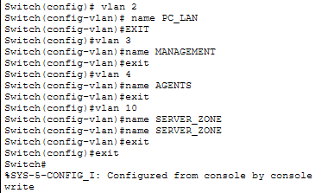
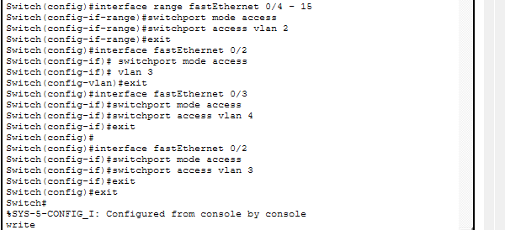
Step 4 – Switch Configuration
SWITCH CONFIG
Create VLANs
Assign Access Ports
vlan 2 → PC_LAN
vlan 3 → MANAGEMENT
vlan 4 → AGENTS
vlan 10 → SERVER_ZONE
fa0/4–fa0/15 → VLAN 2 (PCs)
fa0/2 → VLAN 3 (AP0)
fa0/3 → VLAN 4 (AP1)
fa0/1 → Trunk (Router)

Slide 9
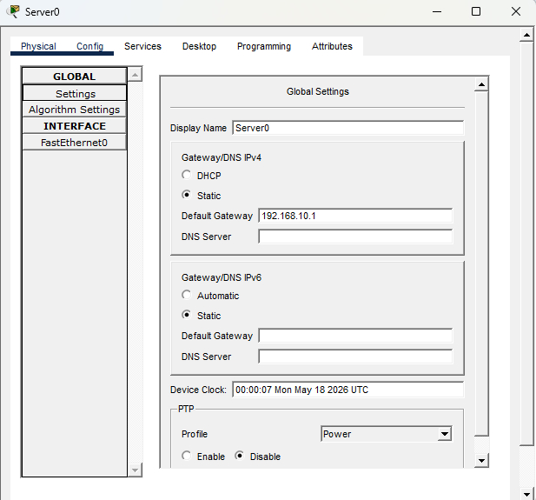
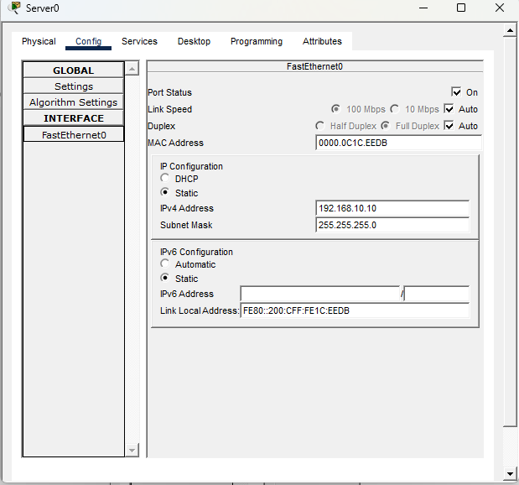
Step 5 – Server Configuration
SERVER CONFIG · STATIC IP + GATEWAY
Server Static IP Configuration
Config tab → GLOBAL → Settings: Default Gateway = 192.168.10.1 │ Config tab → FastEthernet0: IPv4 = 192.168.10.10 / 255.255.255.0
The server must have a static IP so all VLANs can reach it as a fixed DHCP/DNS target via the router helper-address.

Slide 10
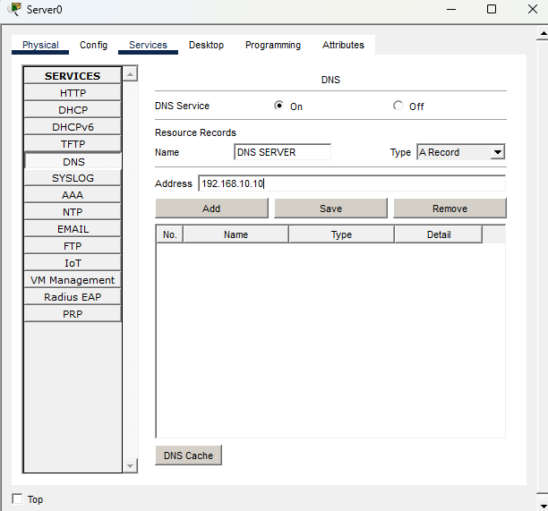
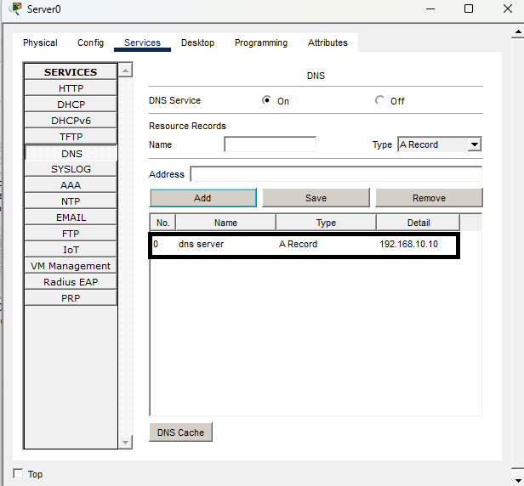
Step 6 – Enable DNS Service
DNS CONFIGURATION
DNS ON
Services → DNS Set to On
A Record
Name: dns server Type: A Record IP: 192.168.10.10
Purpose
Allows clients to resolve hostnames on the corporate network.
💡 Why DNS?
DNS lets devices use friendly names instead of raw IP addresses. Although optional in a lab, it reflects real-world practice where servers are accessed by hostname, not just IP.

Slide 11
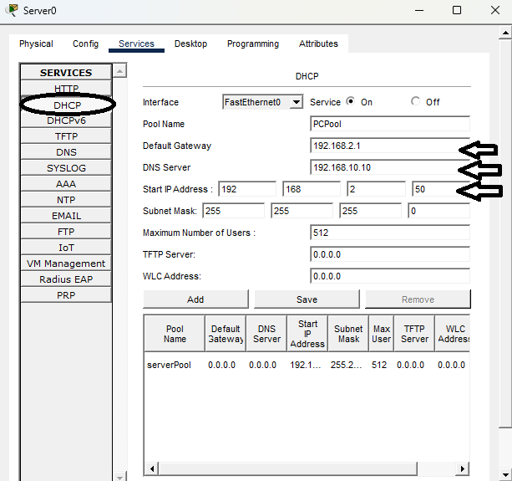
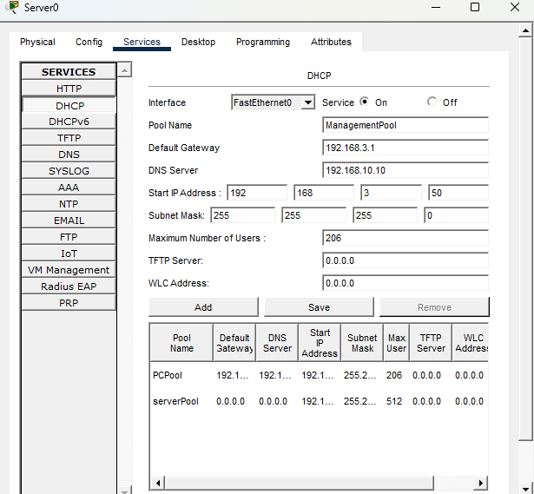
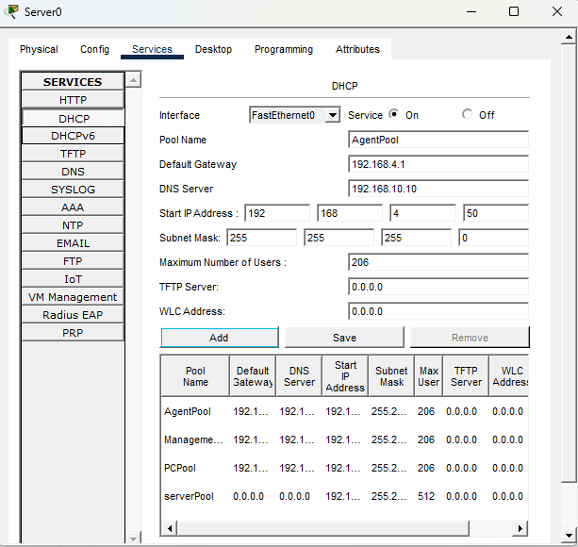
Step 7 – Create DHCP Pools
DHCP CONFIGURATION
Pool Name | Gateway | DNS Server | Start IP | VLAN
PCPool | 192.168.2.1 | 192.168.10.10 | 192.168.2.50 | VLAN 2 – PC_LAN
ManagementPool | 192.168.3.1 | 192.168.10.10 | 192.168.3.50 | VLAN 3 – MANAGEMENT
AgentPool | 192.168.4.1 | 192.168.10.10 | 192.168.4.50 | VLAN 4 – AGENTS
serverPool | 0.0.0.0 | 0.0.0.0 | 192.168.10.50 | VLAN 10 – SERVER_ZONE

Slide 12
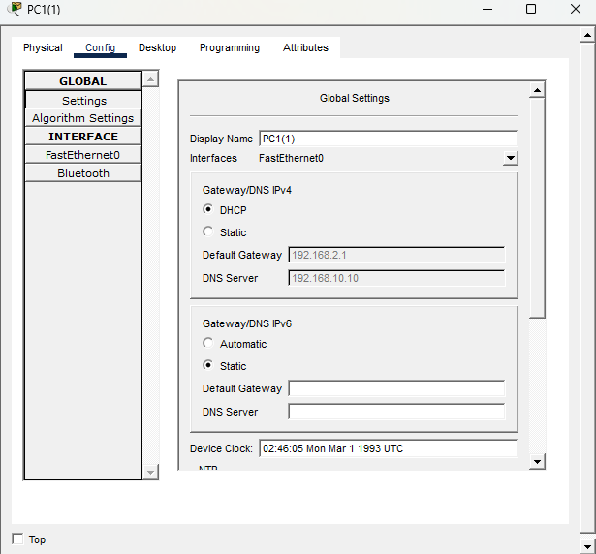
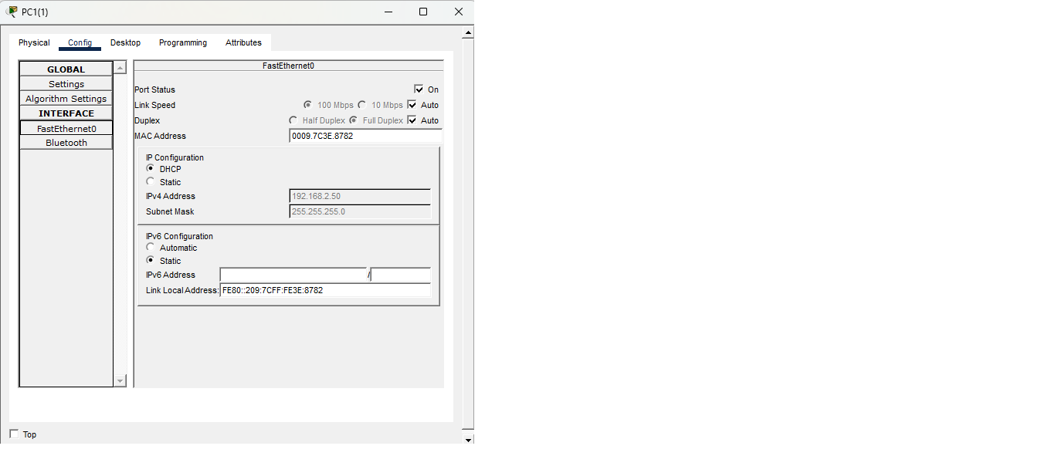
Step 8 – Verify PC DHCP Assignment
DHCP VERIFICATION – PCs
✅ Success – DHCP Working
PC1(1) Config tab shows: DHCP selected | Default Gateway = 192.168.2.1 | DNS Server = 192.168.10.10
FastEthernet0 interface shows IP = 192.168.2.50 assigned from PCPool. The server relay is working correctly.

Slide 13
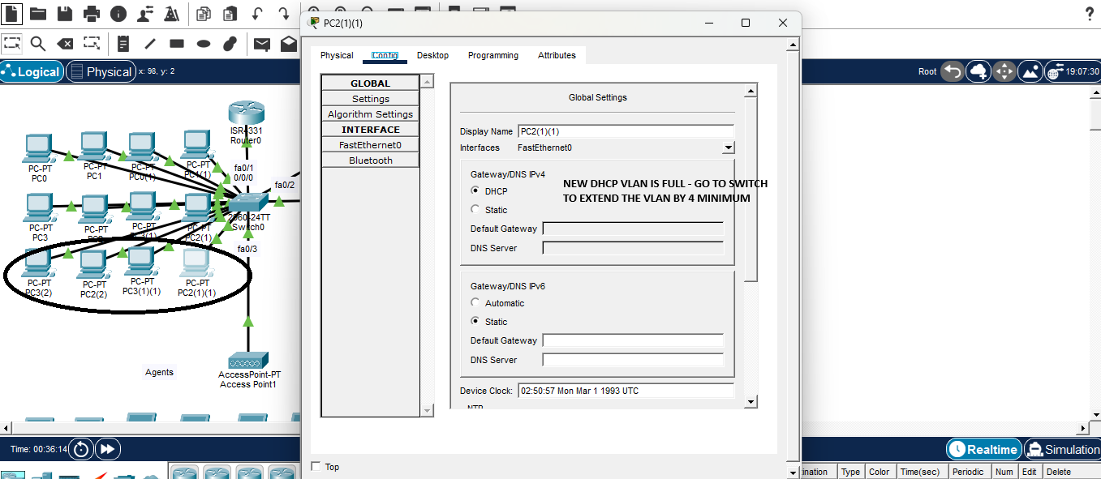
Step 8b – DHCP Pool Exhausted
ISSUE DISCOVERED
🔴 Problem
PC2(1)(1) in VLAN 2 received no IP address.
Default Gateway and DNS Server fields are empty.
Cause: The PCPool only allowed a small range — it ran out of addresses when additional PCs were connected.
✅ Resolution
Go to Server0 → Services → DHCP → PCPool.
Increase the maximum number of users (e.g. 206).
This extended the pool range to accommodate all PCs.
Alternatively, expand via the switch VLAN range.

Slide 14
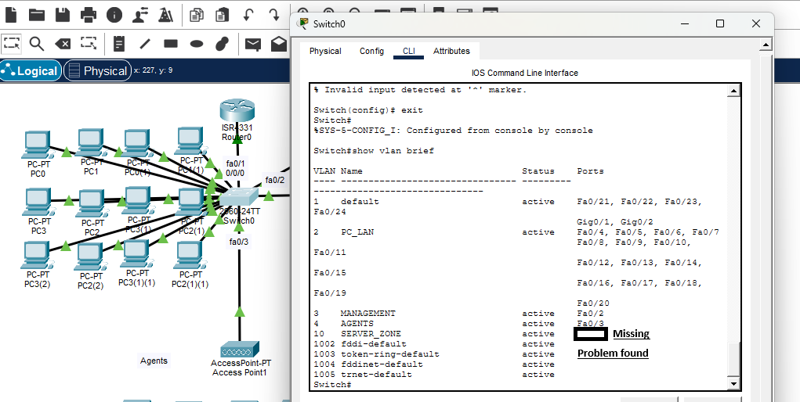
TROUBLESHOOTING
Diagnosing & Fixing
VLAN Issues
Screenshots 019 – 023 | Switch VLAN brief · Trunk verification · Port re-assignment

Slide 15
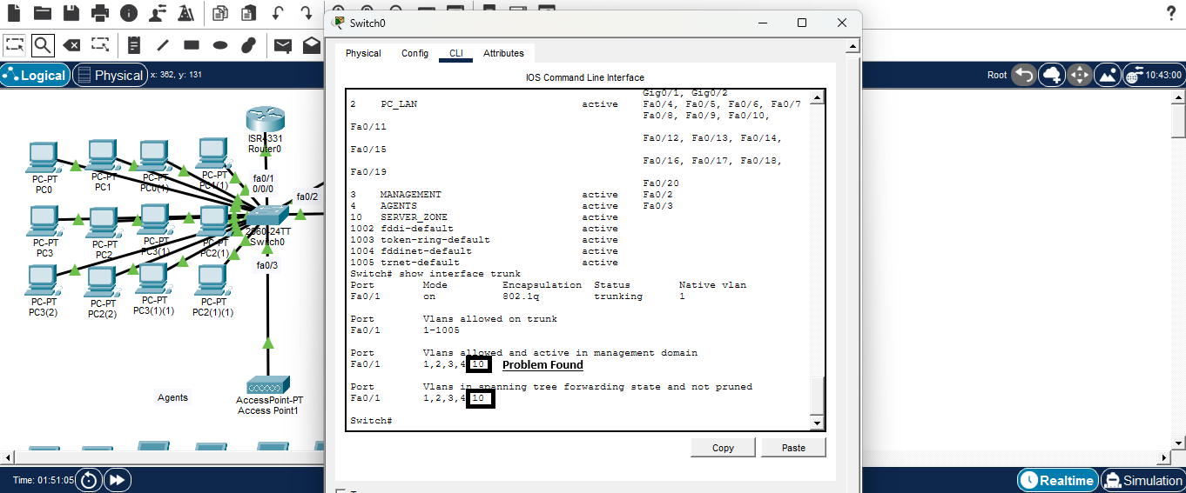
Troubleshooting – Step 1: Diagnose
TROUBLESHOOTING · 019–020
🔍 Symptom
After expanding the VLAN port range, some PCs still failed to get an IP address. Investigation began with Switch0 CLI.
🖥️ Command Used
Switch# show vlan brief
Switch# show interface trunk
🔴 Root Cause Found
VLAN 10 (SERVER_ZONE) had no assigned ports in show vlan brief output. Port fa0/4 was not placed in VLAN 10 — the server was unreachable from the switch fabric.

Slide 16
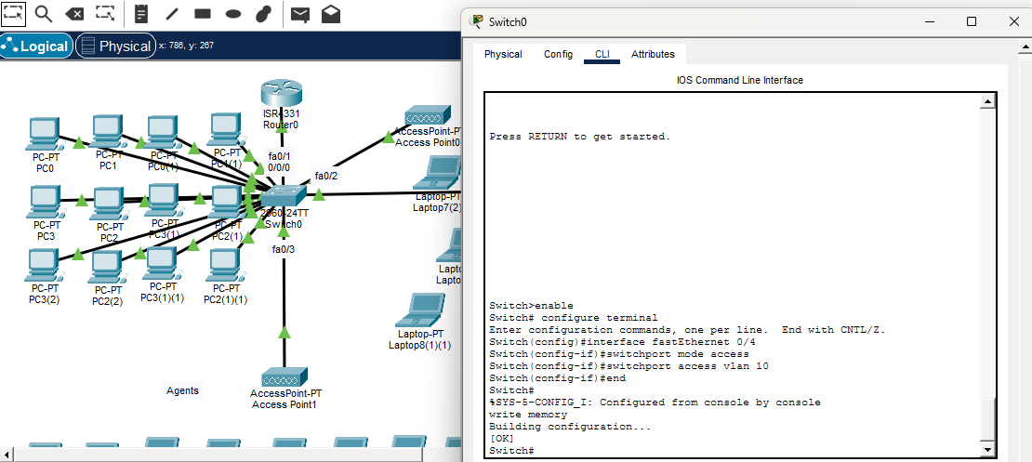
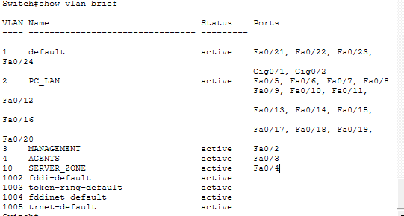
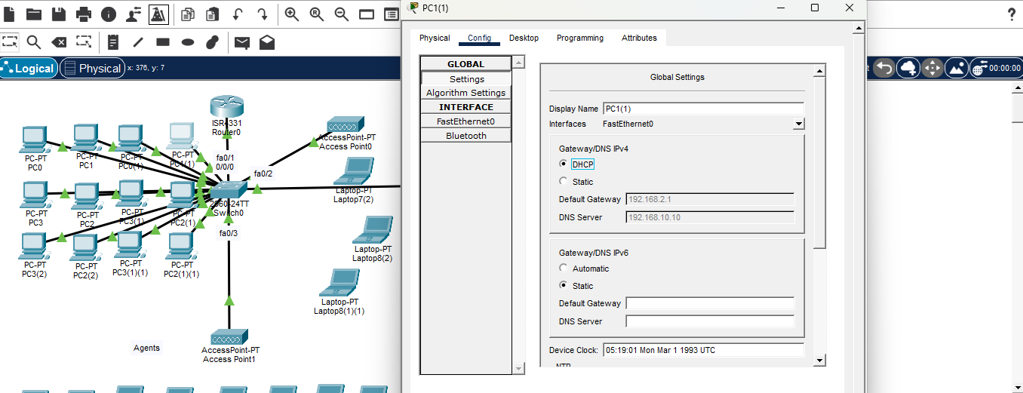
Troubleshooting – Step 2: Apply the Fix
TROUBLESHOOTING · 021–023

Slide 17
Troubleshooting – Summary & Lessons
LESSONS LEARNED
🔍 Symptom
📋 Diagnostic Command
Some PCs had no DHCP-assigned IP address even after correct router and server config was verified.
show vlan brief and show interface trunk on Switch0 revealed that VLAN 10 (SERVER_ZONE) had no port assigned.
🔧 Fix Applied
✅ Result
interface fastEthernet 0/4 → switchport mode access → switchport access vlan 10 → write memory. This connected the server port to the correct VLAN.
show vlan brief confirmed fa0/4 now appears under VLAN 10. PC1(1) Config tab showed DHCP assigned gateway 192.168.2.1 and DNS 192.168.10.10.
💡 Always verify switch VLAN port assignments and trunk allowed VLANs before assuming router or server misconfiguration.

Slide 18
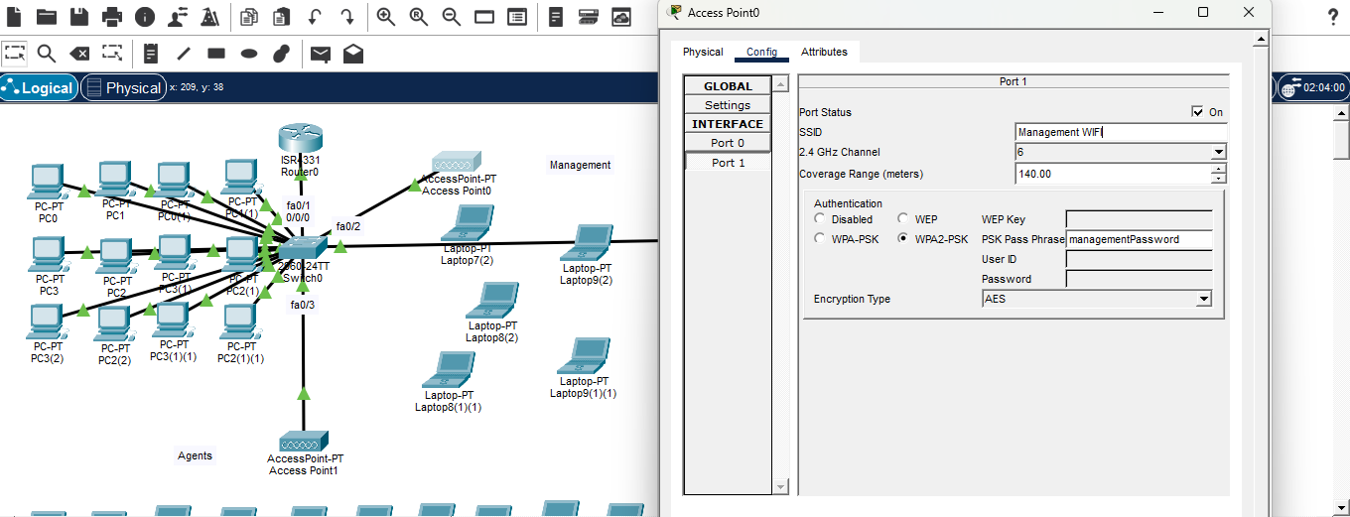
WIRELESS SETUP
Access Points,
Wi-Fi Clients & Verification
Screenshots 024 – 026 | Management SSID · WPA2-PSK · DHCP assigned via VLAN 3

Slide 19
Step 9 – Management Access Point
ACCESS POINT · MANAGEMENT WIFI
Access Point0 Settings
SSID:
Management WiFi
VLAN:
3 – MANAGEMENT
Channel:
6 (2.4 GHz)
Authentication:
WPA2-PSK
Passphrase:
managementPassword
Encryption:
AES
Why WPA2-PSK?
WPA2-PSK with AES provides strong encryption using a pre-shared key — suitable for a corporate lab environment simulating real secure Wi-Fi deployments.

Slide 20
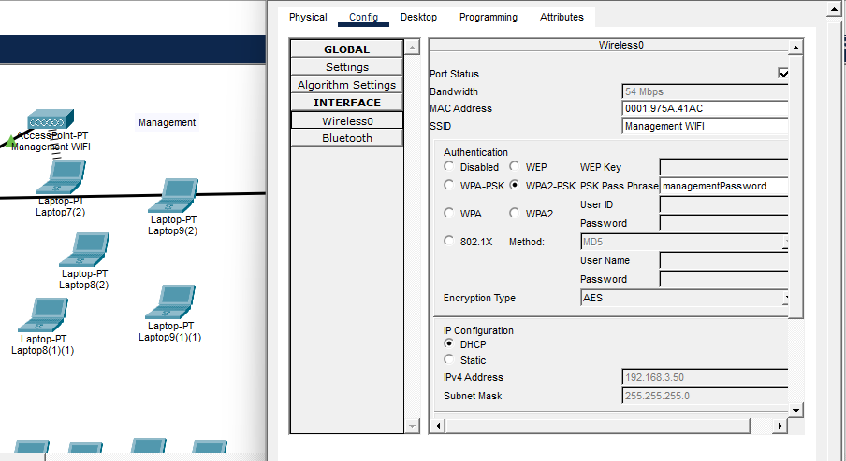
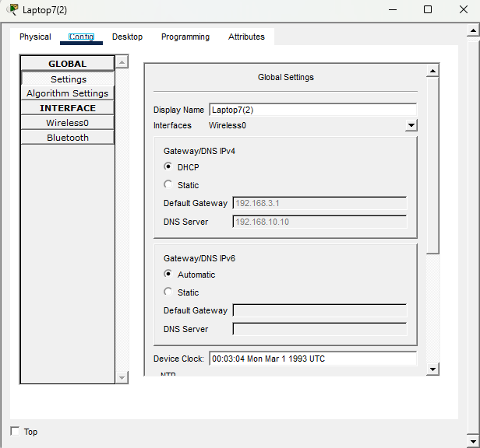
Step 9b – Management Laptop Verification
LAPTOP CONFIG · MANAGEMENT
✅ Management Laptops Connected & DHCP Assigned
Left: Laptop connects via Wireless0, SSID = Management WiFi, WPA2-PSK, IP auto-assigned 192.168.3.50 (VLAN 3 pool).
Right: Global Settings confirm DHCP mode, Default Gateway = 192.168.3.1, DNS = 192.168.10.10.

Slide 21
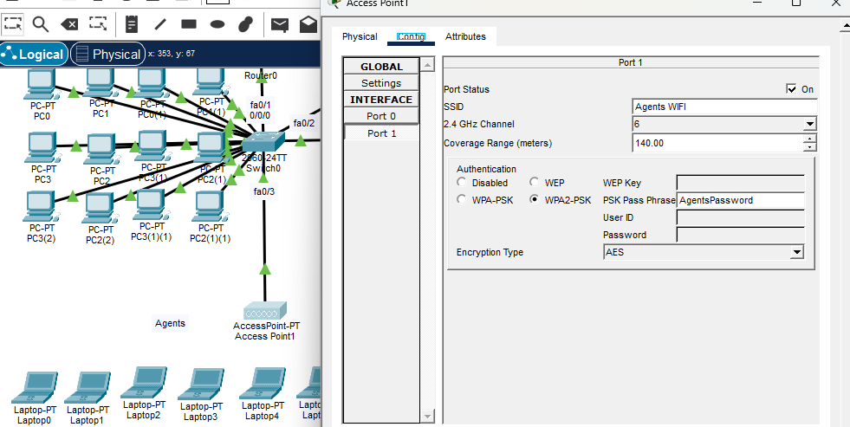
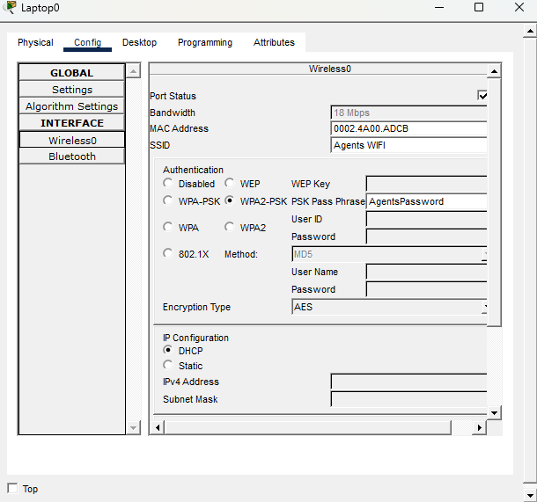
Step 10 – Agents Access Point & DHCP Issue
AGENTS WIFI · SECOND TROUBLESHOOT
Access Point1 Config
🔴 DHCP Not Working for Agents
SSID: Agents WiFi | VLAN 4 – AGENTS
WPA2-PSK | Passphrase: AgentsPassword | AES
Laptop0 connects to Agents WiFi and selects DHCP — but IPv4 Address and Subnet Mask fields remain empty. Root cause: VLAN 4 sub-interface on Router0 was missing.

Slide 22
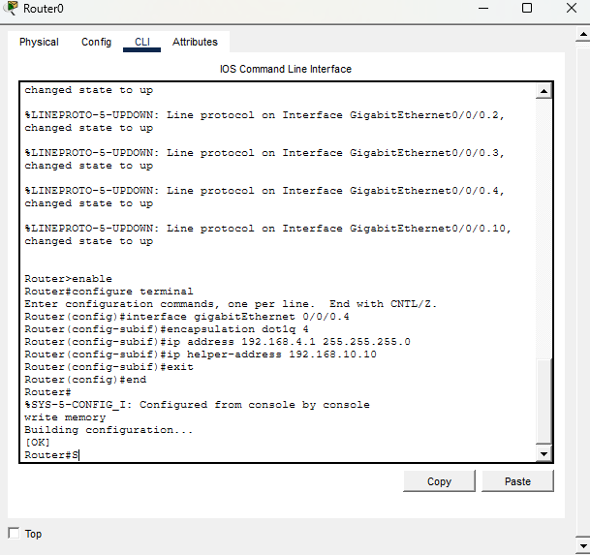
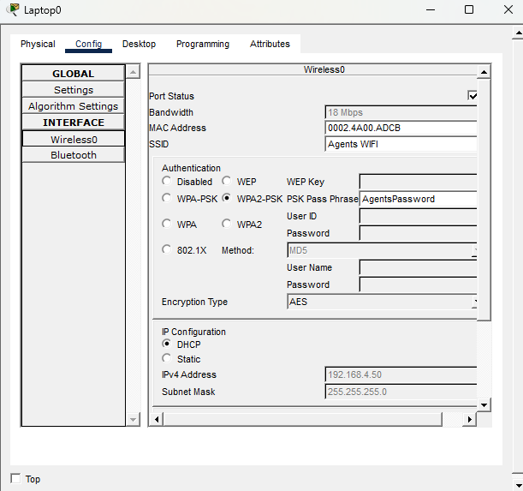
Step 10b – Fix Router VLAN 4 Sub-Interface
FIX · 029–030
CLI Fix
✅ Agents Laptops Now Get DHCP
interface gi 0/0/0.4
encapsulation dot1q 4
ip address 192.168.4.1 255.255.255.0
ip helper-address 192.168.10.10
write memory
Laptop0 Config shows DHCP selected, IPv4 = 192.168.4.50, Subnet 255.255.255.0. DNS = 192.168.10.10. All agents can now communicate via the corporate network.

Slide 23
Final Network Topology
COMPLETED NETWORK

Slide 24
Key Concepts Covered
SUMMARY
🔀 Inter-VLAN Routing
📡 DHCP Relay (helper-address)
🌐 Centralised DNS
Router-on-a-stick using 802.1Q sub-interfaces on a single physical link. Each VLAN gets its own sub-interface with a gateway IP.
ip helper-address forwards client broadcasts as unicast to the central server — essential when DHCP server is on a different VLAN.
A single DNS server handles all VLANs. Clients receive the server IP via DHCP, enabling hostname resolution across the network.
🔌 Switch VLAN Segmentation
📶 WPA2-PSK Wireless
🔍 Systematic Troubleshooting
Ports assigned to specific VLANs for isolation. Trunk port carries all VLANs between switch and router.
Access Points on dedicated VLAN ports provide secure Wi-Fi. Laptops get DHCP from the same central server via router relay.
show vlan brief and show interface trunk commands quickly reveal missing port assignments — always verify the data plane before blaming the server.

Slide 25
CISCO PACKET TRACER · NETWORK SIMULATION
Thank You!
Corporate Network Setup — DNS & DHCP Server Simulation
VLAN Segmentation
Inter-VLAN Routing
Centralised DHCP
DNS Service
WPA2 Wireless
Troubleshooting
Built with Cisco Packet Tracer · For educational purposes

